Slide 1
Policy and Legal Aspects of EM
Module-2
Policy and Legal Aspects of EM:
Introduction to various Environmental Policies
Indian and International Environmental laws and legislation.
EM system Standards:
Core Elements
Benefits
Certification Body Assessment & Documentation for EMS
ISO-14000 Standards.

Slide 2
Introduction to various Environmental Policies
“Man is both creature and moulder of his environment, which gives him physical substance and affords him the opportunity for intellectual, moral, social and spiritual growth”.
The environment is clearly at risk from a variety of sources of harm, mostly of human origin.
In order to tackle this problem it is important that we develop strategies for modifying human behavior towards environmentally benign practices and away from environmentally damaging ones.
Law is important as it creates a framework within which incentives and disincentives human behaviour can operate
Law in a society applies equally to everyone at all times.

Slide 3
The Concept of Law
Law as Commands
Law as Rules
Laws as Principles
Law as Ethics or Morality
Law as Social Norm and Customs
Laws as Written Documents
Law Distinguished From Policy
Law has been described as ‘generally...a way of regulating human behavior”

Slide 4
The Concept of Law
1. Law as Commands
Laws can be seen as commands issued by a self-governing authority and supported by the threat of sanctions.
Example: A government mandates a lockdown during a pandemic and imposes fines or custody for those who violate the restrictions.
The law is a direct command from the state, enforced with penalties.
2. Law as Rules
Laws function as general rules that guide behavior and establish order in society.
Example: Traffic laws dictate that drivers must stop at red lights. These rules ensure road safety and regulate driving behavior.

Slide 5
The Concept of Law
3. Law as Principles
Laws may be based on broader principles that provide guidance rather than strict commands.
Example: The principle of "innocent until proven guilty" in criminal law ensures that individuals are not punished without evidence, influencing how courts interpret and apply laws.
4. Law as Ethics or Morality
Some laws are based on moral or ethical considerations.
Example: Anti-discrimination laws, such as those prohibiting racial or gender discrimination in employment, reflect moral values about equality and justice.

Slide 6
The Concept of Law
5. Law as Social Norms and Customs
Some laws develop from long-standing customs and traditions rather than formal legislation.
Example: Common law marriage, recognized in some jurisdictions, arises from long-term cohabitation and societal acceptance rather than formal registration.
6. Laws as Written Documents
Laws are written down so everyone knows them.
Example: The Constitution is a written document that says how a country should be run.

Slide 7
The Concept of Law
7. Law Distinguished from Policy
Laws are binding rules, whereas policies are guidelines that governments or organizations use to achieve goals.
Example: A law says that kids must go to school. A school policy, however, decides what subjects they will study.
Would you like any part explained further?
6. Laws as Written Documents
Laws are written down so everyone knows them.
Example: The Constitution is a written document that says how a country should be run.

Slide 8
Environmental Law and Policy
Environmental law is a set of rules and agreements that help protect nature from harm caused by people. It includes laws, court decisions, agreements, and policies that aim to keep the air, water, land, and wildlife safe.
Environmental law as a distinct system arose in the 1960s in the major industrial economies. It is fast becoming an important and specialized branch of law.

Slide 9
Environmental Law and Policy
Environmental law deals with important issues related to protecting nature.
Solutions to environmental problems follow legal procedures.
In recent years, environmental law has helped support sustainable development.
Key policy concepts that have shaped environmental laws:
Precautionary principle – Acting carefully to prevent harm before it happens.
Public participation – Allowing people to have a say in environmental decisions.
Environmental justice – Ensuring fairness in environmental protection.
Polluter pays principle – Making those who harm the environment pay for the damage.
New approaches are being explored to improve environmental protection beyond strict government rules.

Slide 10
Various Environmental Policies
Polluter Pays Principle
Meaning: The person or company that causes pollution must pay for the damage.
Example: A factory dumps waste into a river, making the water dirty. The government fines the factory and makes it clean up the pollution.
Precautionary Principle
Meaning: If an action might harm the environment, steps should be taken to prevent damage, even if there is no full scientific proof.
Example: A new chemical is found to possibly harm fish in lakes. The government bans it until further studies prove it is safe.
Sustainable Development Policy
Meaning: Using natural resources in a way that meets today's needs without harming future generations.
Example: A company plants new trees for every tree it cuts down, ensuring forests remain for the future.

Slide 11
Various Environmental Policies
Public Participation Policy
Meaning: People should have a say in decisions that affect the environment.
Example: Before building a new dam, the government holds meetings to hear concerns from local communities.
Conservation of Natural Resources Policy
Meaning: Protecting natural resources like water, forests, and wildlife.
Example: A law is passed to ban hunting rare animals to protect them from short-lived.
Waste Management Policy
Meaning: Managing waste properly to reduce pollution and promote recycling.
Example: Cities introduce recycling programs where people separate plastic, paper, and organic waste for better disposal.

Slide 12
Various Environmental Policies
Renewable Energy Policy
Meaning: Encouraging the use of clean energy sources like wind, solar, and hydro instead of fossil fuels.
Example: The government gives subsidies to people who install solar panels on their homes.

Slide 13
Indian and International Environmental laws and legislation.
The Environment Protection Act, 1986
Purpose: Gives the government power to take action to protect the environment.
Example: After the Bhopal Gas Tragedy in 1984, this law was passed to prevent similar disasters by regulating industries.
The Air (Prevention and Control of Pollution) Act, 1981
Purpose: Controls air pollution by setting limits on emissions from industries and vehicles.
Example: The Delhi government banned older diesel vehicles and introduced the Odd-Even rule to control air pollution.
The Water (Prevention and Control of Pollution) Act, 1974
Purpose: Prevents water pollution by controlling wastewater discharge from industries.
Example: Factories near the Ganga River are monitored to stop them from dumping waste into the river.
https://www.bing.com/videos/riverview/relatedvideo?q=Bhopal+Gas+Tragedy+in+1984&&mid=C45C1784C7793A2B5111C45C1784C7793A2B5111&FORM=VCGVRP
Bing Videos
https://www.bing.com/videos/riverview/relatedvideo?&q=Factories+and+cities+were+dumping+untreated+waste+into+the+Ganga+River%2c+making+it+highly+polluted.&&mid=6B1EE14F864FE83A4CC96B1EE14F864FE83A4CC9&&FORM=VRDGAR
Bing Videos

Slide 14
Indian and International Environmental laws and legislation.
The Wildlife Protection Act, 1972
Purpose: Protects animals, birds, and plants by creating wildlife sanctuaries and national parks.
Example: The law helped save the Bengal tiger by setting up Project Tiger and banning hunting.
The Forest Conservation Act, 1980
Purpose: Restricts the use of forest land for non-forest activities to protect trees and wildlife.
Example: Mining projects in forest areas need special approval before cutting trees.
The National Green Tribunal (NGT) Act, 2010
Purpose: Establishes a special court to handle environmental cases quickly.
Example: NGT ordered a ban on plastic in some states to reduce pollution.
https://www.bing.com/videos/riverview/relatedvideo?&q=indian+disasters&&mid=ED78D360852E5590C8EFED78D360852E5590C8EF&&FORM=VRDGAR
Bing Videos
Bing Videos

Slide 15
EM system Standards:
Core Elements
Benefits
Certification Body Assessment & Documentation for EMS
ISO-14000 Standards.

Slide 16
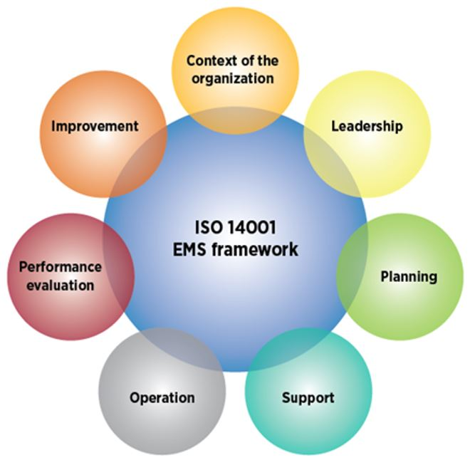
Core Elements of Environmental Management
Environmental Management involves systematic approaches to minimize environmental impacts, comply with regulations, and promote sustainability.
The core elements of an Environmental Management System (EMS) ensure organizations manage their environmental responsibilities effectively.
The image represents the ISO 14001 EMS (Environmental Management System) framework, which consists of key elements required for an effective environmental management system.

Slide 17
Core Elements of Environmental Management
1. Context of the Organization
This involves understanding internal and external factors that can affect environmental management.
Identifying environmental conditions, risks, and opportunities.
Understanding stakeholders’ expectations and regulatory requirements.
Aligning EMS with the organization’s strategic direction.
Example: A manufacturing company identifies that its biggest environmental impact is air pollution due to emissions from its production processes. It also considers external factors like government environmental regulations and customer expectations for sustainable products.

Slide 18
Core Elements of Environmental Management
2. Leadership
Leadership plays a crucial role in integrating environmental management into an organization’s processes.
Establishing and maintaining an environmental policy.
Assigning roles and responsibilities for environmental management.
Ensuring sufficient resources for EMS implementation.
Example: The CEO of a chemical company signs an environmental policy committing to reducing hazardous waste by 30% over five years. The leadership team allocates resources and ensures employees are trained in waste management.

Slide 19
Core Elements of Environmental Management
3. Planning
Planning ensures that environmental objectives align with organizational goals.
Identifying environmental aspects and impacts.
Setting measurable environmental objectives (e.g., reducing carbon emissions).
Assessing risks and opportunities related to environmental issues.
Developing strategies for legal and regulatory compliance.
Example: A textile factory plans to reduce water consumption by 20% by installing water recycling systems. They assess risks such as possible regulatory fines if water usage is not controlled and opportunities like cost savings from reduced water bills.

Slide 20
Core Elements of Environmental Management
4. Support
Support involves resources, training, and communication needed for EMS implementation.
Providing financial, technical, and human resources.
Training employees on environmental responsibilities.
Establishing communication channels for EMS awareness.
Managing documented information to ensure transparency.
Example: A construction company provides training to all employees on eco-friendly building practices. It also establishes a digital system to document and communicate environmental performance data across all project sites.

Slide 21
Core Elements of Environmental Management
5. Operation
This focuses on the practical application of the EMS framework.
Implementing operational controls to prevent environmental harm.
Managing waste, energy use, and emissions efficiently.
Ensuring emergency preparedness and response plans are in place.
Example: A food processing plant installs air filters to control emissions and sets up waste segregation bins to ensure proper disposal of organic and non-organic waste. They also develop an emergency response plan for chemical spills.

Slide 22
Core Elements of Environmental Management
6. Performance Evaluation
Monitoring and measuring EMS effectiveness is essential for continuous improvement.
Conducting internal audits and performance assessments.
Evaluating compliance with environmental laws and policies.
Identifying areas for improvement through data-driven analysis.
Example: An automotive company conducts an internal audit to measure its carbon footprint. It finds that its energy consumption has decreased by 15% since implementing energy-efficient lighting and machines.

Slide 23
Core Elements of Environmental Management
7. Improvement
Continuous improvement is key to ensuring long-term sustainability.
Addressing non-conformities and taking corrective actions.
Enhancing environmental performance through innovation and best practices.
Updating EMS policies based on evaluation results.
Example: A paper manufacturing company discovers during an environmental audit that waste paper recycling is only 60% efficient. They improve the process by adding a new recycling system, increasing efficiency to 85%.

Slide 24
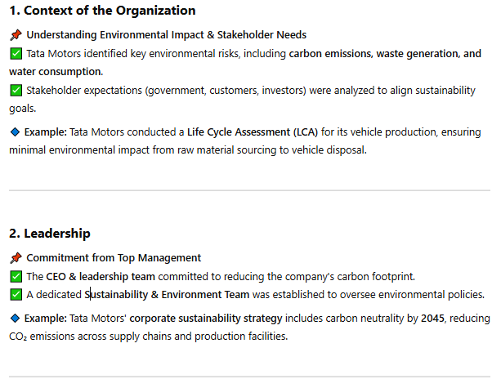
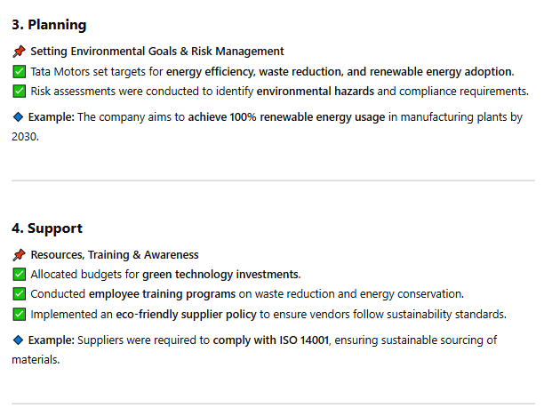
Case Study:Core Elements of Environmental Management & Their Implementation at Tata Motors

Slide 25
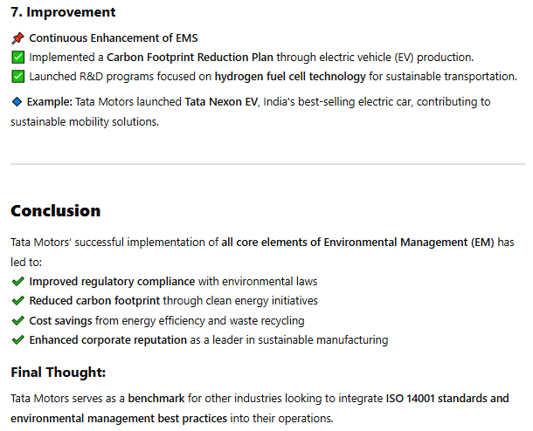
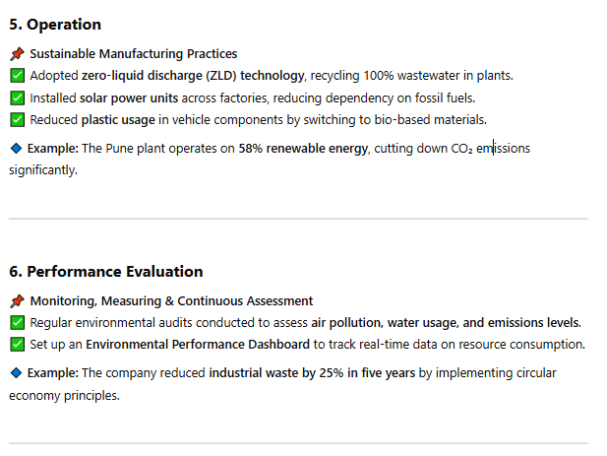
Case Study:Core Elements of Environmental Management & Their Implementation at Tata Motors

Slide 26
Benefits of Environmental Management (EM) Standards
1. Regulatory Compliance (Ensures Adherence to Environmental Laws)
📌 Benefit: Helps organizations comply with environmental regulations, avoiding fines and legal action. 🔹 Example: A pharmaceutical company adopts ISO 14001 to ensure its waste disposal methods comply with government regulations. As a result, the company avoids heavy fines for improper hazardous waste disposal.
2. Cost Reduction (Lower Energy, Waste & Resource Costs)
📌 Benefit: Reduces operational costs through energy efficiency, waste reduction, and resource optimization. 🔹 Example: A textile factory installs water recycling systems, reducing freshwater consumption by 30%. This lowers water bills and improves profitability.

Slide 27
Benefits of Environmental Management (EM) Standards
3. Improved Environmental Performance (Reduces Pollution & Carbon Footprint)
📌 Benefit: Helps organizations reduce emissions, waste, and environmental damage. 🔹 Example: A cement manufacturing plant switches from coal to alternative fuels, reducing CO₂ emissions by 40% and contributing to a cleaner environment.
4. Enhanced Corporate Reputation (Boosts Public Image & Stakeholder Trust)
📌 Benefit: Demonstrates environmental responsibility, improving brand image and customer trust. 🔹 Example: A hotel chain adopts an EMS to minimize waste and energy use, attracting eco-conscious tourists and increasing bookings.

Slide 28
Benefits of Environmental Management (EM) Standards
5. Increased Market Opportunities (Access to Eco-Friendly Markets & Certifications)
📌 Benefit: Many customers prefer environmentally responsible suppliers, creating new business opportunities. 🔹 Example: A packaging company gets ISO 14001 certification, allowing it to supply eco-friendly packaging to multinational corporations that prioritize sustainability.
6. Better Risk Management (Prepares for Environmental Risks & Emergencies)
📌 Benefit: Helps organizations identify and mitigate environmental risks such as spills, accidents, and resource shortages. 🔹 Example: A chemical plant develops an emergency response plan for spills, reducing environmental damage and liability in case of an accident.

Slide 29
Benefits of Environmental Management (EM) Standards
7. Employee Engagement & Awareness (Encourages a Green Work Culture)
📌 Benefit: Employees become more environmentally aware, leading to better sustainability practices. 🔹 Example: A retail company trains employees on waste reduction and sustainable procurement, reducing plastic packaging waste by 50%.
8. Legal Protection & Reduced Liabilities (Avoids Environmental Lawsuits & Fines)
📌 Benefit: Minimizes the risk of lawsuits or penalties related to environmental harm. 🔹 Example: A mining company follows environmental best practices, preventing groundwater contamination and avoiding lawsuits from local communities.

Slide 30
Benefits of Environmental Management (EM) Standards
9. Supply Chain Sustainability (Encourages Eco-Friendly Suppliers & Operations)
📌 Benefit: Helps businesses ensure their suppliers follow environmental standards. 🔹 Example: A car manufacturer requires all its suppliers to follow ISO 14001, ensuring that components are sourced sustainably.
10. Continuous Improvement & Innovation (Drives Sustainable Innovations & Efficiency Gains)
📌 Benefit: Encourages businesses to adopt new technologies and improve sustainability. 🔹 Example: A solar panel company continuously improves its production process, reducing material waste by 25% while increasing energy efficiency.

Slide 31
Certification Body Assessment & Documentation for Environmental Management System (EMS)
1. Certification Body Assessment for EMS
To achieve ISO 14001 certification, an organization must undergo an assessment by an accredited Certification Body (CB). The process involves evaluating whether the organization’s Environmental Management System (EMS) meets ISO 14001 requirements.
2. Documentation Required for EMS Certification
Proper documentation is crucial for ISO 14001 certification, as it provides evidence of EMS implementation and effectiveness.

Slide 32
Steps in Certification Body Assessment:
1.1 Pre-Assessment (Optional)
Some organizations opt for a pre-audit to identify gaps before the formal certification audit.
Helps in early identification of non-conformities.
1.2 Stage 1 Audit (Document Review & Readiness Check)
The certification body reviews EMS documentation to ensure compliance with ISO 14001 requirements.
Verifies if environmental policies, risk assessments, and objectives are in place.
Checks regulatory compliance and legal frameworks.
Assesses whether the EMS is implemented effectively.

Slide 33
Steps in Certification Body Assessment:
1.3 Stage 2 Audit (On-Site Assessment)
On-site visit to evaluate how EMS is applied in daily operations.
Interviews employees to check awareness and responsibility.
Assesses compliance with environmental laws and policies.
Identifies any non-conformities and provides corrective action requests.
1.4 Certification Decision
If the organization meets ISO 14001 requirements, the certification body issues an ISO 14001 certificate (valid for 3 years).
If major non-conformities exist, certification is withheld until corrective actions are verified.

Slide 34
Steps in Certification Body Assessment:
1.5 Surveillance Audits (Annual Review)
Conducted annually to ensure continuous compliance with ISO 14001.
Any non-conformities must be addressed within a specified timeframe.
1.6 Recertification Audit (Every 3 Years)
A full EMS reassessment is conducted before certification renewal.

Slide 35
Key EMS Documents:
2.1 Mandatory Documents (Required by ISO 14001)
✅ Environmental Policy – Outlines the organization’s commitment to sustainability. ✅ Environmental Aspects & Impact Assessment – Identifies significant environmental risks. ✅ Legal & Compliance Register – Lists relevant environmental regulations. ✅ Environmental Objectives & Targets – Defines measurable goals (e.g., reduce emissions by 20%). ✅ Roles & Responsibilities Document – Assigns EMS responsibilities to staff. ✅ Operational Control Procedures – Describes processes to manage environmental impacts (e.g., waste disposal, pollution control). ✅ Emergency Preparedness & Response Plan – Outlines procedures for environmental incidents (e.g., oil spills, chemical leaks). ✅ Monitoring & Measurement Records – Data on emissions, waste management, energy usage, etc. ✅ Internal Audit Reports – Results of periodic EMS evaluations. ✅ Corrective & Preventive Action Records – Documents how non-conformities are addressed. ✅ Management Review Meeting Minutes – Evidence of leadership involvement in EMS decisions.

Slide 36
Key EMS Documents:
2.2 Additional Supporting Documents (Recommended but not mandatory)
✔️ Training Records – Proof of employee EMS training. ✔️ Stakeholder Communication Records – Communication with regulatory bodies or local communities. ✔️ Supplier & Contractor Environmental Policies – Ensuring suppliers follow environmental best practices. ✔️ Carbon Footprint & Sustainability Reports – Demonstrates corporate social responsibility (CSR).

Slide 37
3. Importance of Certification Body Assessment & Documentation
📌 Ensures Compliance – Certification proves adherence to ISO 14001 and environmental laws. 📌 Improves Environmental Performance – Identifies and mitigates risks effectively. 📌 Enhances Corporate Image – Demonstrates commitment to sustainability and attracts eco-conscious customers. 📌 Facilitates Continuous Improvement – Annual audits encourage better environmental management. 📌 Supports Market Competitiveness – Many clients and suppliers require ISO 14001 certification.
The certification body assessment is a structured evaluation process that ensures an organization’s EMS meets ISO 14001 standards. Proper documentation is essential for certification and ongoing compliance. By following this structured approach, businesses can achieve sustainability, legal compliance, and operational efficiency.

Slide 38
ISO-14000 Standards for environmental Management
1. What is ISO 14000?
ISO 14000 is a family of international standards developed by the International Organization for Standardization (ISO) to help organizations manage their environmental responsibilities effectively. These standards provide a framework for organizations to: ✅ Reduce environmental impact ✅ Ensure compliance with environmental regulations ✅ Improve sustainability and efficiency
The most widely recognized standard in this family is ISO 14001, which outlines the requirements for an Environmental Management System (EMS).

Slide 39
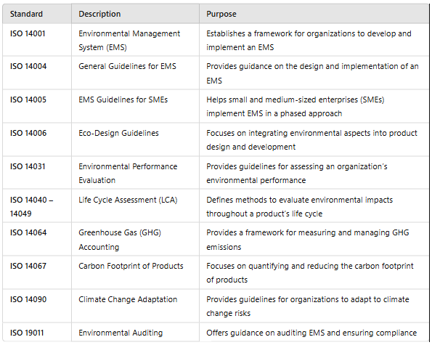
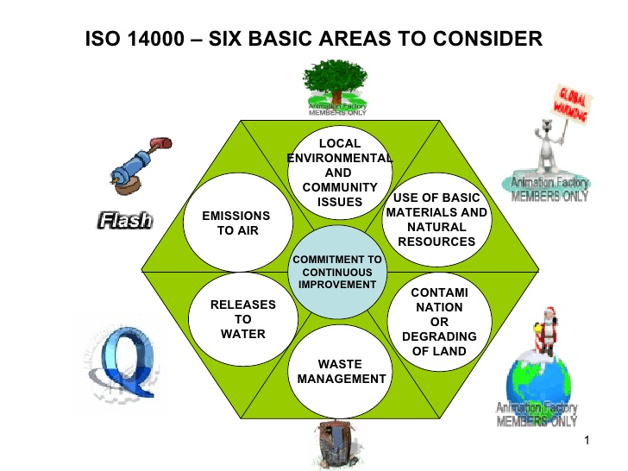
2. Key ISO 14000 Standards & Their Purpose

Slide 40
3. Benefits of Implementing ISO 14000 Standards
✅ 1. Compliance with Environmental Regulations
🔹 Example: A manufacturing company follows ISO 14001 to ensure it meets pollution control laws and avoids fines.
✅ 2. Reduction of Environmental Impact
🔹 Example: A construction company adopts ISO 14040 (Life Cycle Assessment) to minimize waste and carbon emissions in building projects.
✅ 3. Cost Savings & Operational Efficiency
🔹 Example: A textile factory follows ISO 14031 (Performance Evaluation) to reduce water and energy consumption, cutting operational costs.
✅ 4. Improved Corporate Reputation & Market Access
🔹 Example: A packaging company obtains ISO 14067 (Carbon Footprint) certification, attracting environmentally conscious clients.
✅ 5. Risk Management & Climate Change Adaptation
🔹 Example: A food processing plant follows ISO 14090 (Climate Adaptation) to prepare for extreme weather conditions affecting supply chains.

Slide 41
4. Steps to Implement ISO 14001 (EMS) in an Organization
Step 1: Establish an Environmental Policy
Define objectives such as waste reduction, pollution control, and energy efficiency.
Step 2: Identify Environmental Aspects & Impacts
Analyze operations to find activities affecting the environment (e.g., emissions, water use).
Step 3: Set Goals & Objectives
Create measurable targets (e.g., reduce carbon emissions by 20% in 5 years).
Step 4: Implement the EMS
Train employees, allocate resources, and integrate environmental practices into daily operations.
Step 5: Monitor & Measure Performance
Conduct environmental audits, track progress, and identify areas for improvement.
Step 6: Continuous Improvement
Regularly update policies and practices based on audit findings and performance data.

Slide 42
Summary
So,
ISO 14000 standards provide a structured approach for organizations to improve their environmental performance, reduce risks, and ensure compliance with regulations.
By implementing these standards, companies can achieve sustainability goals, reduce costs, and enhance their reputation.

Slide 43
THANK YOU

